Slide 1

Basic of Electrical and Electronics Engineering (BEEE)
By
Dr. G. Ramesh

Slide 2
Syllabus for B.Tech. I year II Semester B.Tech. CSE (DS)
Basic Electrical and Electronics Engineering (BEEE)
Unit – I: Fundamentals of Electrical Engineering and DC Machines:
Ohm’s Law, Kirchhoff’s Laws, types of sources, passive elements. Series parallel circuits, mesh and nodal analysis. Superposition, Reciprocity theorem.
DC Machines: Principle of operation of D.C generators, types, E.M.F equation. Principle of operation of D.C motors, Types motors, Torque equation, Losses and efficiency, simple problems on D.C Generators and motors.
Unit – II: Fundamentals of AC circuits:
AC voltage wave form and basic definitions: Peak Value, R.M.S. value, Average values, Form factor and Peak factor, ’j’ operator, Analysis of single phase AC circuits series and parallel (Simple circuits). Three phase circuits – Star - delta connection, Relation between line and phase voltages / currents in a 3-phase Star-Delta balanced system.

Slide 3
Unit – III: Induction Motors and Instruments:
Concept of Faraday’s laws, 3- phase induction motor working principle, operation and construction details.
Instruments: Introduction, classification of instruments, operating principles, essential features of measuring instruments, permanent magnet moving coil (PMMC) instruments, moving iron (MI) instruments.
Unit –IV: Diode:
Overview of Semiconductors, PN junction diode and Zener diode –Diode circuits: rectifiers (bridge type only), filters, clippers and clampers.
UNIT -V: Transistor:
BJT construction, operation, characteristics (CB, CE and CC configurations) and uses – JFET and MOSFET construction, operation, characteristics (CS configuration) and uses.

Slide 4
UNIT VI -Digital Electronics:
Number systems – binary codes –binary arithmetic – Boolean algebra, laws &amp; theorems - simplification of Boolean expression using K maps - logic gates -implementation of Boolean expressions is using logic gates - standard forms of Boolean expression.
Text Books:
1. Basic Electrical Engineering –T.K. Nagesarkar and M.S. Sukhja, Oxford University Press.2 nd
edition.
2. Basic electrical Engineering – M.S. Naidu and S. Kamakshiah – TataMcGraw-Hill, 2005
edition.
3. Principles of Electronics - V.K.Mehta, S.Chand Publications, 2nd edition.
References:
1. Theory and problems of Basic electrical Engineering- D.P.Kotahari &amp; I.J.Nagrath PHI.
Electronic Devices and Circuits, Millman &amp; Halkias, TMH publications. nit –IV:

Slide 5
Unit-I: Syllabus
Ohm’s Law
Kirchhoff’s Laws (KVL and KCL)
Types of Sources
Passive Elements
Series and Parallel Circuits
Mesh and Nodal Analysis
Superposition and Reciprocity Theorems
DC Machines

Slide 6
Principle of operation of D.C generators
Types of D.C generators
E.M.F equation
Principle of operation of D.C motors
Types of D.C motors, Torque equation
Losses and efficiency calculation in D.C Generators and D.C motors.
Text BooK: Basic Electrical Engineering by T.K.Nagsarkar and M.S.Sukhja Oxford University Press.2nd edition

Slide 7
Energy (W)
The energy is the capacity to do work, and the unit of work or energy is measured in joule ( J ).
Energy may exist many forms such as mechanical, chemical, electrical and so on. The energy is neither be created and nor be destroyed.
Electrical energy is the product of power multiplied by the length of time it was consumed.

Slide 8
Power (P)
Electrical power is the rate per unit time, at which electrical energy is transferred by an electric circuit.
Electric power is usually produced by electric generators, but can also be supplied by sources such as electric batteries.
The SI unit of power is the watt (W), one joule per second.

Slide 9
When small change in energy is dw and change in time dt, then power equation is
the power is expressed in millwatts (mW), microwatts (µW), kilowatt (KW) and megawatt (MW)

Slide 10
one watt is amount of power generated when one joule of energy consumed in one second.
Thus, the number of joules consumed in one second is always equal to number of watts.
Pro.1: What is the power in watts if energy equals to 100 J is used in 2.5 seconds?

Slide 11
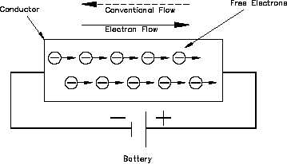
Current (I)
Current is defined as the rate of flow of electrons in a conductive or semi conductive material.
The movement of electrons from one end of the material to other end constitutes an electrical current, denoted by I and measured in ampere (A).
The conventional direction of current flow is opposite to flow of electrons.

Slide 12
It is measured by number of electrons that flow past a point in unit time,
One ampere is equal to one coulomb per second.
Pro.2: 50 C of charge flow fast a given point in 4 s. How many amperes of current is flowing?
Pro.3: A 100 W fan is working at 230V supply, what is the current and number of electrons passing through the fan in every second.

Slide 13
Voltage (V)
Electrical voltage is defined as electric potential difference between two points of an electric field.
It is denoted by V, it is expressed in terms of energy (W) per unit charge (Q).
Charge (Q) is measured in coulombs (C), one coulomb of charge carried by

Slide 14
One volt is the potential difference between two points when one joule of energy is used to pass one coulomb of charge from one point to other.
Pro.4: if 80 J of energy is available for every 20 C of charge, what is the voltage?

Slide 15
Ohm’s Law
Ohm's Law deals with the relationship between Voltage, Current and Resistance in any DC electrical circuit at constant temperature.
This relationship states that: the electrical current (I) flowing in an circuit is proportional to the voltage (V) and inversely proportional to the resistance (R).

Slide 16
The resistor's current I is equal to the resistor's voltage V divided by the resistance R
The voltage V is equal to the current I times the resistance R
The resistance R is equal to the voltage V divided by the current I

Slide 17
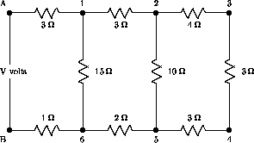
Network Terminology
Network : Any arrangement of the various electrical energy sources along with the different circuits elements is called an electrical network.
Network Element or Branch: Any individual circuit element with two terminals which can be connected to other circuit element, is called a network element.

Slide 18
Junction or Node : A point at which three or more elements are joined together is called node.
Loop or Mesh : It is a set of branches forming a closed path in a network in such a way that if one branch is removed then remaining branches do not form a closed path.
Kirchhoff’s Law
Kirchhoff's Circuit Laws allow us to solve complex circuit problems by defining a set of basic network laws and theorems for the voltages and currents around a circuit. Which are classified into two types KVL and KCL.

Slide 19
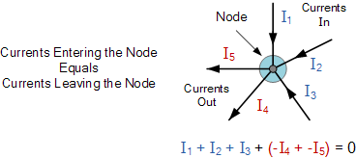
Kirchhoff's Current Law (KCL)
KCL states that the sum of current entering into any node is equal to the sum of the currents leaving that node.
The node may be an interconnection of two or more branches.

Slide 20
Here, the three currents entering the node, I₁, I₂, I₃ are all positive in value and the two currents leaving the node, I₄ and I₅ are negative in value.
Then this means we can also rewrite the equation as
I₁ + I₂ + I₃ – I₄ – I₅ = 0
We can use Kirchhoff’s current law when analyzing parallel circuits.

Slide 21
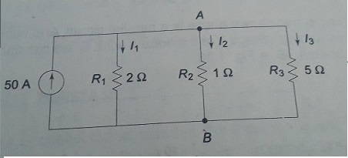
Pro.5: Determine the current in all resistors in the circuits shown in figures.

Slide 22
Kirchhoff's Voltage Law (KVL)
KVL, states that “in any closed loop network, the total voltage around the loop is equal to the sum of all the voltage drops within the same loop” which is also equal to zero.
In other words the algebraic sum of all voltages within the loop must be equal to zero.
When current passes through a resistor, there is a loss of energy and voltage drop across the resistor.

Slide 23
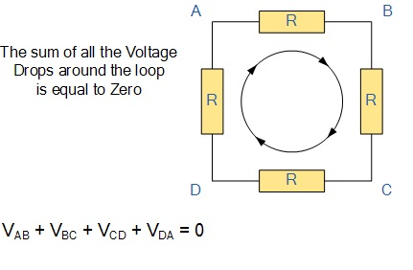
Starting at any point in the loop continue in the same direction noting the direction of all the voltage drops, either positive or negative, and returning back to the same starting point. We can use KVL when analyzing series circuits.

Slide 24
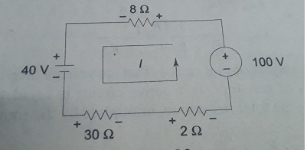
Pro.6: What is the current in the circuit shown in figure?. Determine the voltage across each resistor.

Slide 25
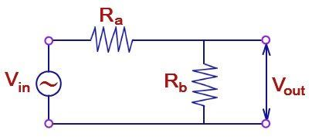
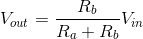
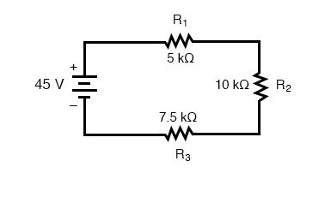
Voltage Division Rule
A series circuit acts as a voltage divider. Since the same current flow through each resistors.
The voltage drop proportional to the values of the resistors.
Using this principle, different voltages can be obtained from a single voltage source, called a voltage divider rule.
Find the voltage across R2 resistance using voltage division rule shown in above figure.

Slide 26
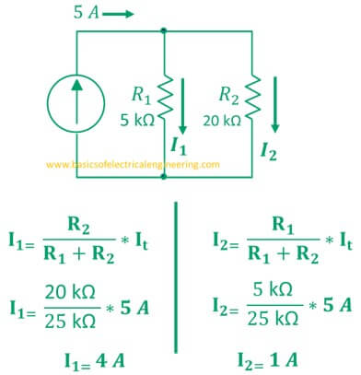
Current Division Rule
A parallel circuit acts as a current divider as the current divides in all the branches in a parallel circuit, and the voltage remains the same across them.
The total current entering into the parallel branches is divided into the branches currents according to the resistance values.
The branch having higher resistance allows lesser currents and the branch with lower resistance allows more current.

Slide 27
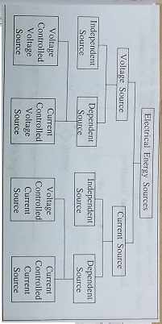
Type of Sources

Slide 28
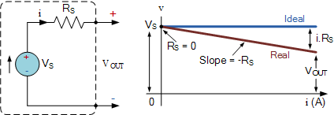
Independent Voltage Source
According to voltage–current characteristics, Independent voltage source is expressed in ideal as well as practical case.
Ideal case: An ideal voltage source is a two terminal element in which the voltage V is completely independent of the current I.
In practical voltage sources, the internal resistance is represented in series with the source, where voltage across the terminals falls as the current through it increases.

Slide 29
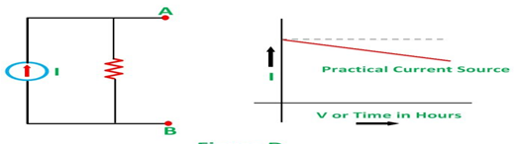
Independent Current Source
According to voltage–current characteristics, Independent current source is expressed in ideal as well as practical case.
An ideal constant source is a two-terminal element in which the current I is completely independent of the voltage V across it terminals.
In practical current sources, the resistance is in parallel with the source, where magnitude of current falls as the voltage across its terminals increases.

Slide 30
Network Elements
Network elements may be classified into four groups
Active and Passive : Voltage source and current source, resistors, capacitors and inductors.
A circuit which contains at least one source of energy called active. A circuits which not contains any energy source is called passive circuit.
Unilateral and bilateral : Diodes and Rectifiers, where circuit operation depends on direction of currents.

Slide 31
Linear and non-linear: V=IR, A circuit whose parameters i.e. elements like resistances, inductances and capacitances are always constant irrespective of the change in time, voltage and temperature.
Lumped and distributive: resistors and capacitor and inductors and transmission lines. A network in which the circuit elements are physically separable is known as lumped elements. Cannot be physically separable for analysis purposes is called distributed elements.

Slide 32
Passive Elements
A passive element is an electrical component that does not generate power, but instead dissipates, stores, and/or releases it.
Passive elements include resistances, capacitors, and coils (also called inductors).

Slide 33
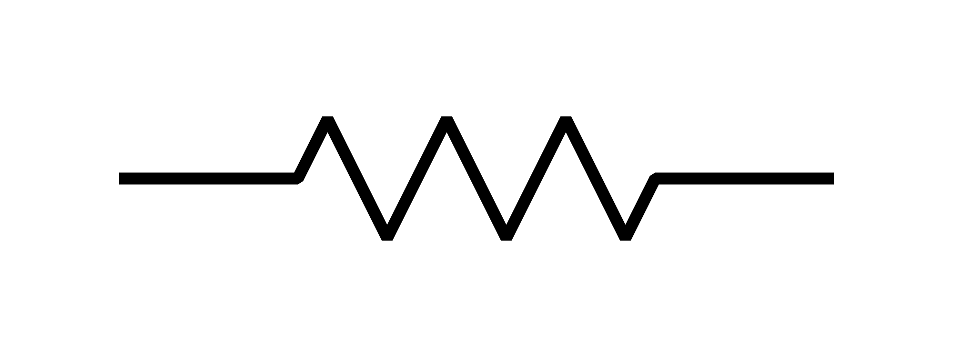
Resistor
The property of a material to restrict the flow of electrons is called resistor, denoted by R.
The unit of resistance is ohm ( ) . Ohm is defined as the resistance offered by material when a current of one ampere flows between two terminals with one volt applied across it.

Slide 34
According to ohms law, the current is inversely proportional to total resistance of the circuit, i.e.
The power absorbed by the resistor is converted to heat.

Slide 35
Energy lost in a resistance in time t is given by
This loss of energy per unit charge is the drop in potential across the material.
Pro.7: A 56 ohm resistor is connected to 10 V battery, what is the power and energy consumed by the resistors.

Slide 36
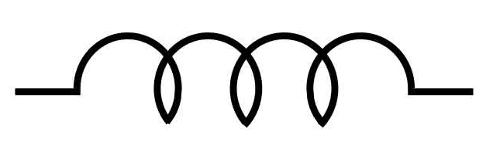
Inductor or Inductance
A wire of certain length, when twisted into a coil becomes a basic inductor, denoted by L.
If current is made to pass through an inductor, an electromagnetic field is formed.
A change in magnitude of the current changes the electromagnetic field.

Slide 37
The unit of inductance is henry H, the inductance is one henry when current through the coil, changing at rate of one ampere per second, induces one volt across the coil.
The current-voltage relation is given by
The power absorbed by the inductor is

Slide 38
The energy stored by the inductor is
The property of inductor
The induced voltage across an inductor is zero if the current through it is constant.
A small change in current within zero time through an inductor gives an infinite voltage across the inductor.

Slide 39
The inductor can store finite amount of energy, even if the voltage across the inductor is zero, and
A pure inductor never dissipates energy, only stores it. That is why it is also called as a non-dissipative passive element.
Pro.8: The current in a 2 H inductor varies at a rate of 2 A/s. Find the voltage across the inductor and energy stored in the magnetic field after 2 seconds.

Slide 40
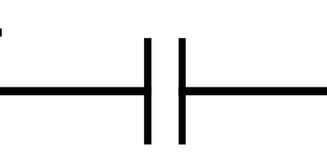
Capacitor or Capacitance
Any two conducting surfaces separated by an insulating medium exhibit the property of capacitor, denoted by C and measured in farad F.
The conducting surfaces are called electrodes, and the insulating medium is called dielectric.
A capacitor stores energy in the form of an electric field that is established by the opposite charges on the two electrodes.

Slide 41
A capacitor is said to have greater capacitance if it can store more charge per unit voltage and the capacitance is given by
The current flowing through the capacitor is

Slide 42
The power absorbed by capacitor is given by
The energy stored by the capacitor is
The property of Capacitor
The current in capacitor is zero if the voltage across it is constant.
A small change in voltage across a capacitor within zero time gives an infinite current through the capacitor.

Slide 43
The capacitor can store finite amount of energy, even if the current through it is zero, and
A pure capacitor never dissipates energy, only stores it. That is why it is also called as a non-dissipative passive element.
Pro.9: A capacitor having a capacitance 5 micro farad is charged to a voltage 230 V. Calculate the stored energy in joules.

Slide 44
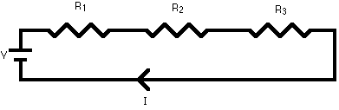
Series Circuits
A series circuit is a circuit in which resistors are arranged in a chain, so the current has only one path to take.
In a series circuit, the current through each of the components is the same, and the voltage across the circuit is the sum of the voltages across each component.

Slide 45
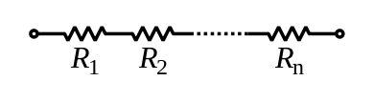
The total resistance of resistors in series is equal to the sum of their individual resistances:
Electrical conductance presents a reciprocal quantity to resistance. Total conductance of a series circuits of pure resistors, therefore, can be calculated from the following expression:

Slide 46


Inductor follow the same law, in that the total inductance of non-coupled inductors in series is equal to the sum of their individual inductances:
Capacitors follow the same law using the reciprocals. The total capacitance of capacitors in series is equal to the reciprocal of the sum of the reciprocals of their individual capacitances:

Slide 47
Parallel Circuits
Parallel circuit is a circuit in which the resistors are arranged with their heads connected together, and their tails connected together.
The current in a parallel circuit breaks up, with some flowing along each parallel branch and re-combining when the branches meet again.
The voltage across each resistor in parallel is the same.
The total resistance of a set of resistors in parallel is found by adding up the reciprocals of the resistance values, and then taking the reciprocal of the total:

Slide 48
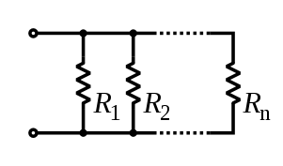
Since electrical conductance is reciprocal to resistance, the expression for total conductance of a parallel circuit of resistors reads

Slide 49
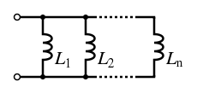

Inductor follow the same law, in that the total inductance of non-coupled inductors in parallel is equal to the reciprocal of the sum of the reciprocals of their individual inductances:
The total capacitance of capacitor in parallel is equal to the sum of their individual capacitances:

Slide 50
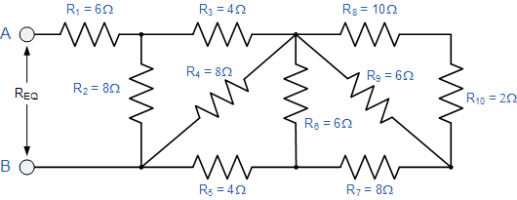
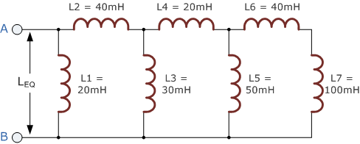
Pro.10: Find the equivalent resistance, R_{EQ} for the following resistor combination circuit Fig(a).
Fig(a) Fig(b)
Pro.11: Find the equivalent inductance, L_{EQ} for the following inductor combination circuit Fig(b).

Slide 51
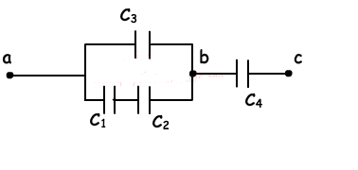
Pro.12: In the circuit given below, C1=60µF, C2=20 µF, C3=9 µF and C4=12 µF. If the potential difference between points a and c is Vac= 120V, find the charge of capacitor Qac.

Slide 52
Mesh Analysis
Mesh and nodal analysis are two basic important techniques which are useful to find solution of a network.
The suitability of either mesh or nodal analysis to a particular problem mainly depends on the number of voltage sources or current sources.
If a network has a large number of voltage sources, it is useful to use mesh analysis; if the network has more current sources use nodal analysis method.
Mesh required only voltage sources, if there are any current sources in a circuit they are to be converted into equivalent voltage sources.

Slide 53
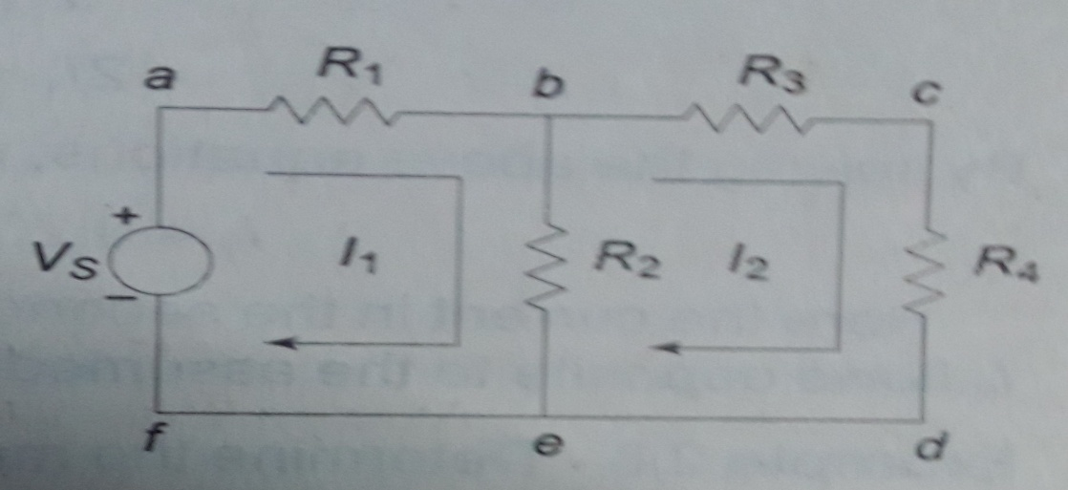
In figure there are two loops abef and bcdeb in the network.
Let us assume loop currents and with directions as indicated in figure. Considering the loop abef alone, observe that current is passing through and is passing through .
By applying KVL, it can be written as
(1)

Slide 54
Similarly loop bcdeb applying KVL and written as
(2)
By rearranging above equation (1) and (2)
(3)
(4)
By solving equation (3)&(4), find the current
The no. of mesh currents equals to no. of mesh equations.

Slide 55
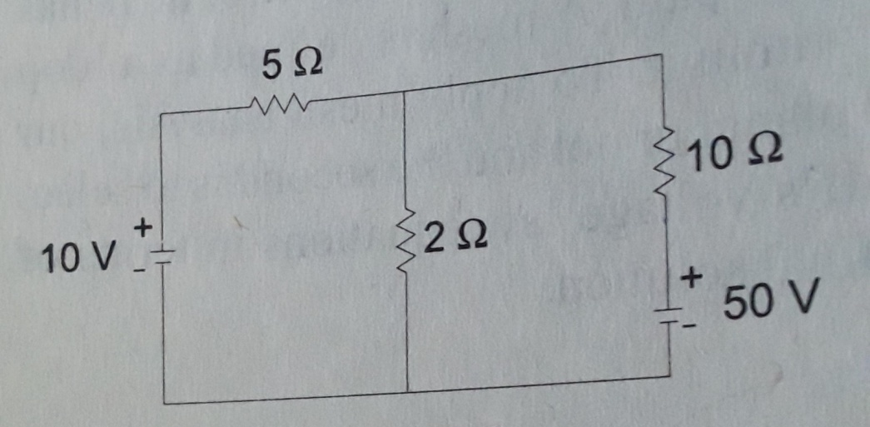
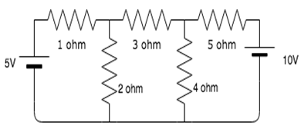
Pro.13: Write mesh current equations and find currents in the given circuits.

Slide 56
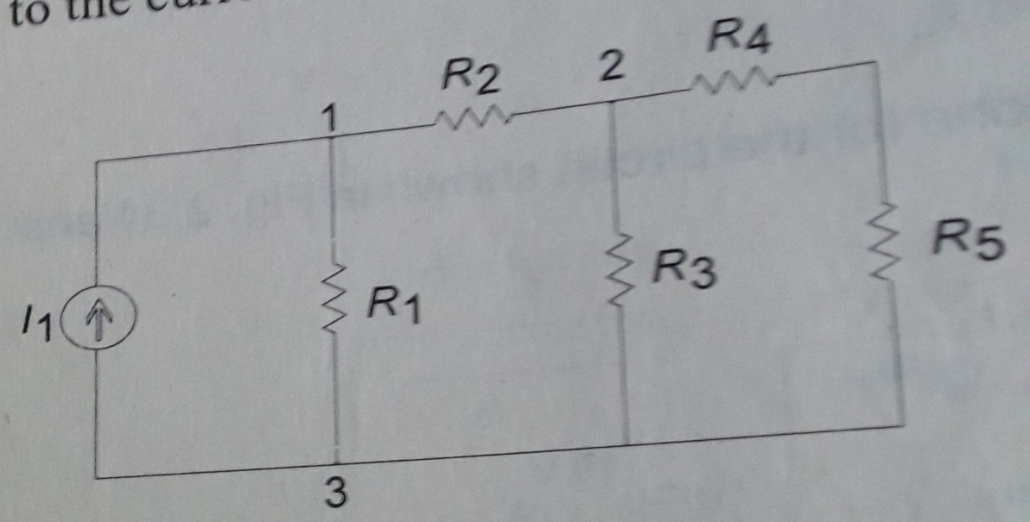
Nodal Analysis
The node voltage is the voltage of a given node with respect to reference node, which is assumed at zero potential.
In figure the node 3 is assumed as reference node, the voltage at node 1 is the voltage at that node w.r.to node 3. Similarly, voltage at node 2 is w.r.to node 3.

Slide 57
Applying KCL at node 1, the current entering equals to current leaving.
(1)
Where are the voltage at node 1 &2. Similarly, apply KCL at node 2,
(2)
Rearranging above equation (1) and (2)
(3)

Slide 58
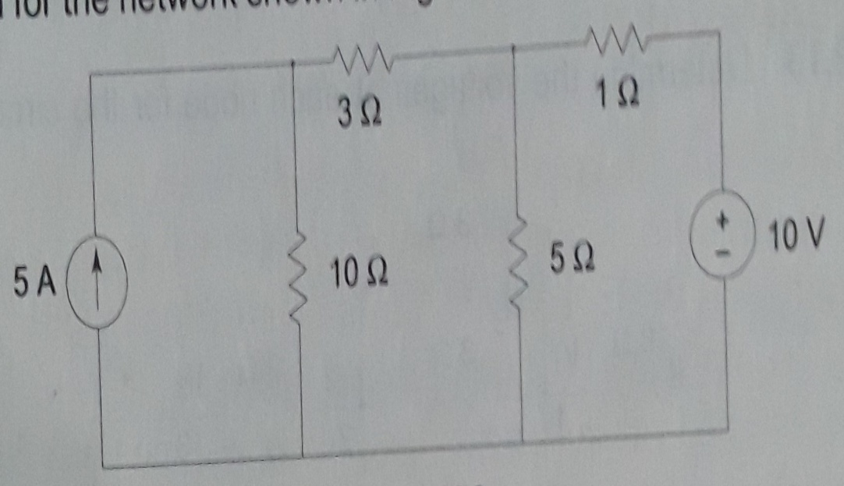
By solving equation (3)&(4), find the voltage .
(4)
Pro.14: Write node voltage equations and determines the currents in each branch for the network shown in the figure

Slide 59
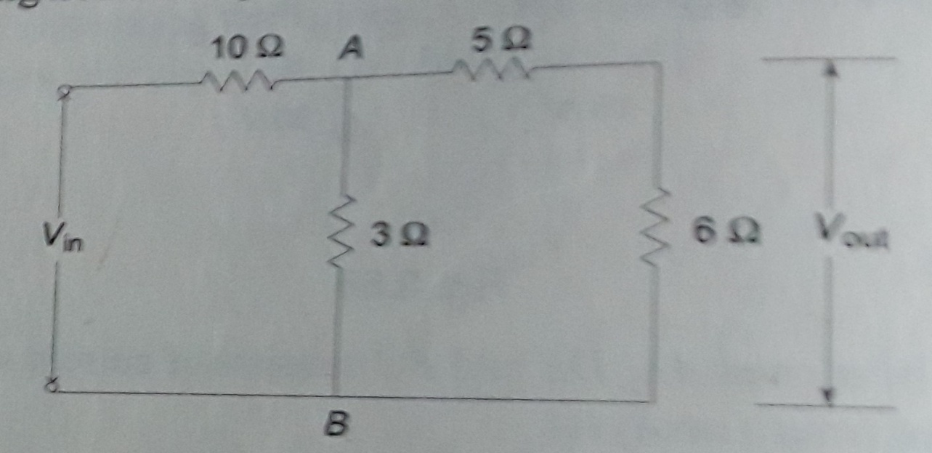
Pro.15: Determine the voltage ratio for circuit shown in fig by using nodal analysis.

Slide 60
Superposition Theorem
The superposition theorem states that in any linear network containing two or more sources, the response in any element is equal to the algebraic sum of the response caused by individual source acting alone, while other sources are non-operative.
Where the ideal voltage and current sources are replaced by open and short circuits in the network.

Slide 61
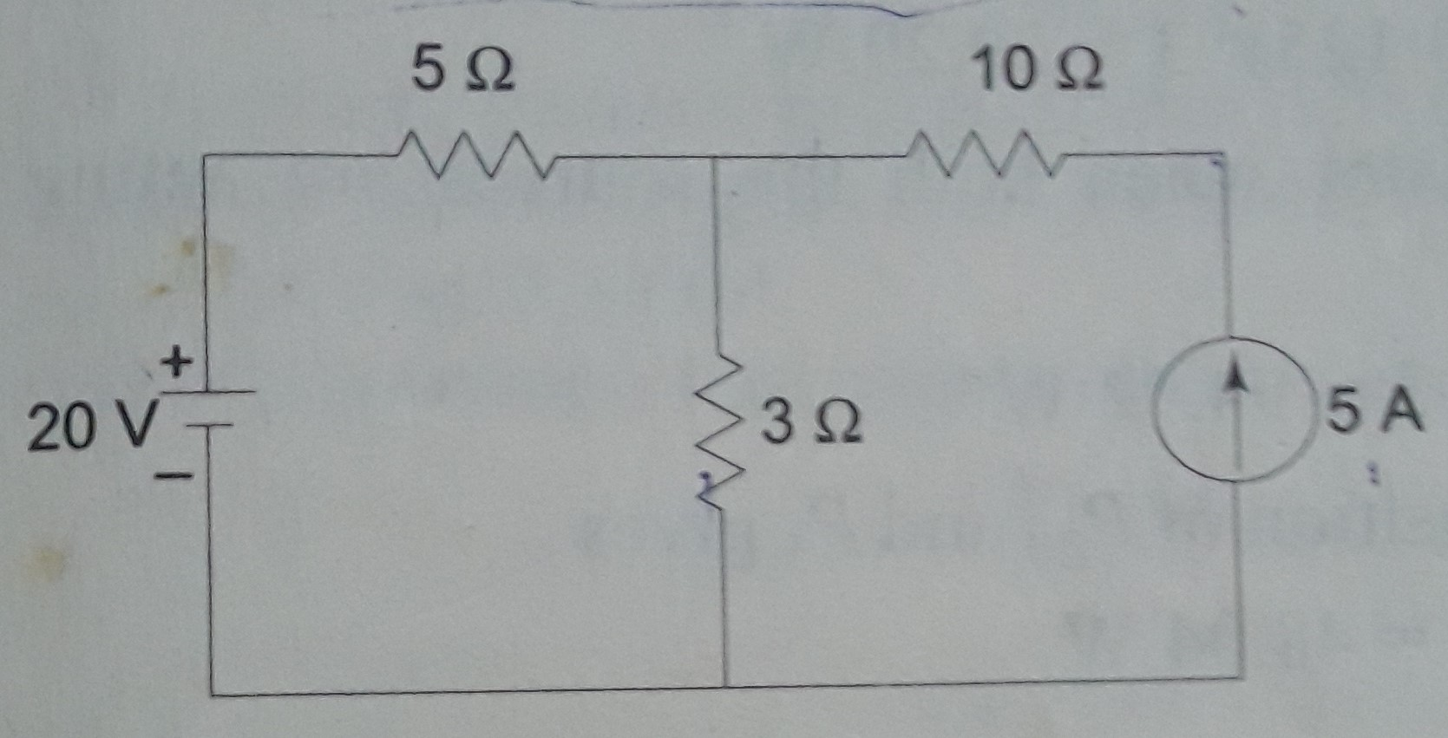
Pro.15: Using superposition principle, find the currents and power in each branch for the network shown in the figure.

Slide 62
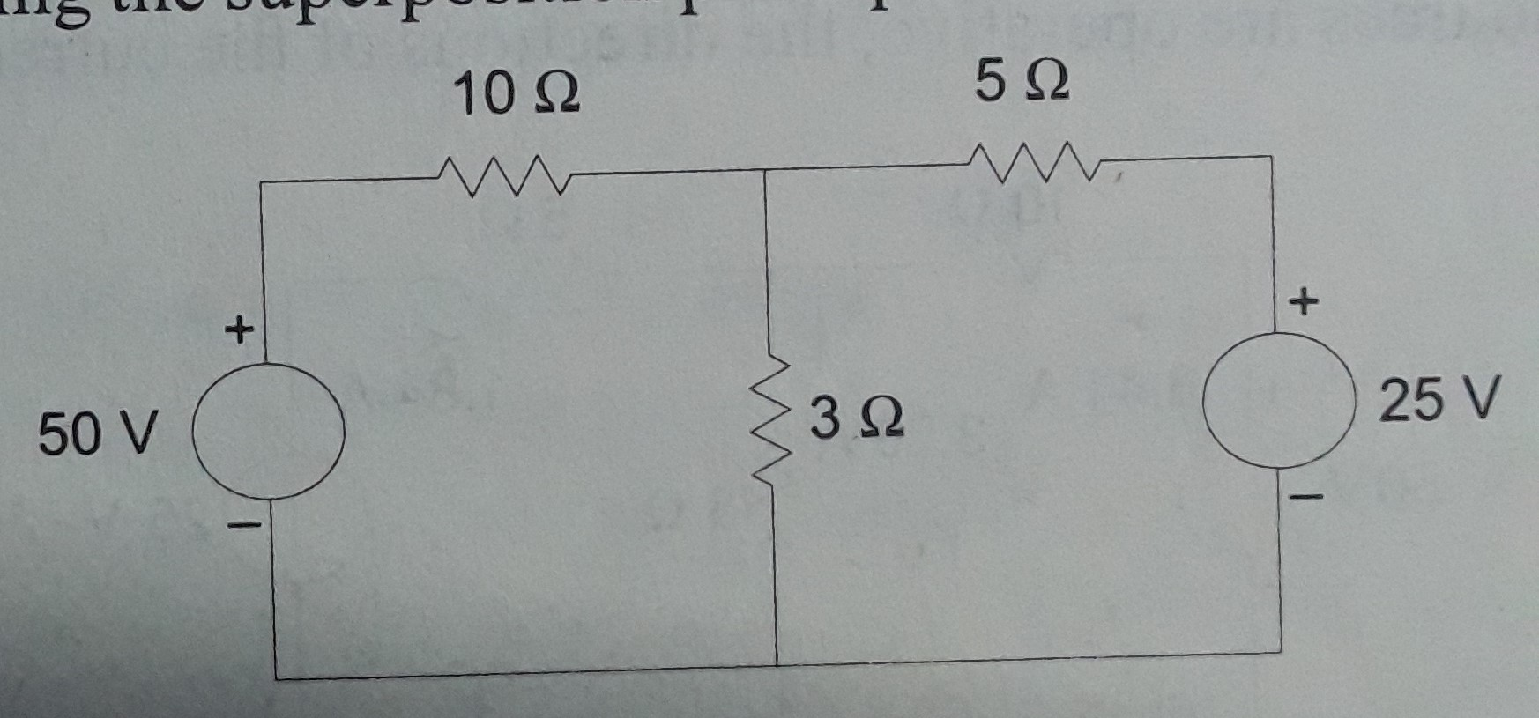
Pro.16: For the resistive network shown in figure, find the current in 3 ohm resistor.

Slide 63
Reciprocity Theorem
This theorem applicable for only linear and bilateral single network.
It stats that if some excitation is given to a circuit which consist of passive elements, then the ratio of response in any element to excitation is constant even when the position of excitation and response are interchanged.

Slide 64
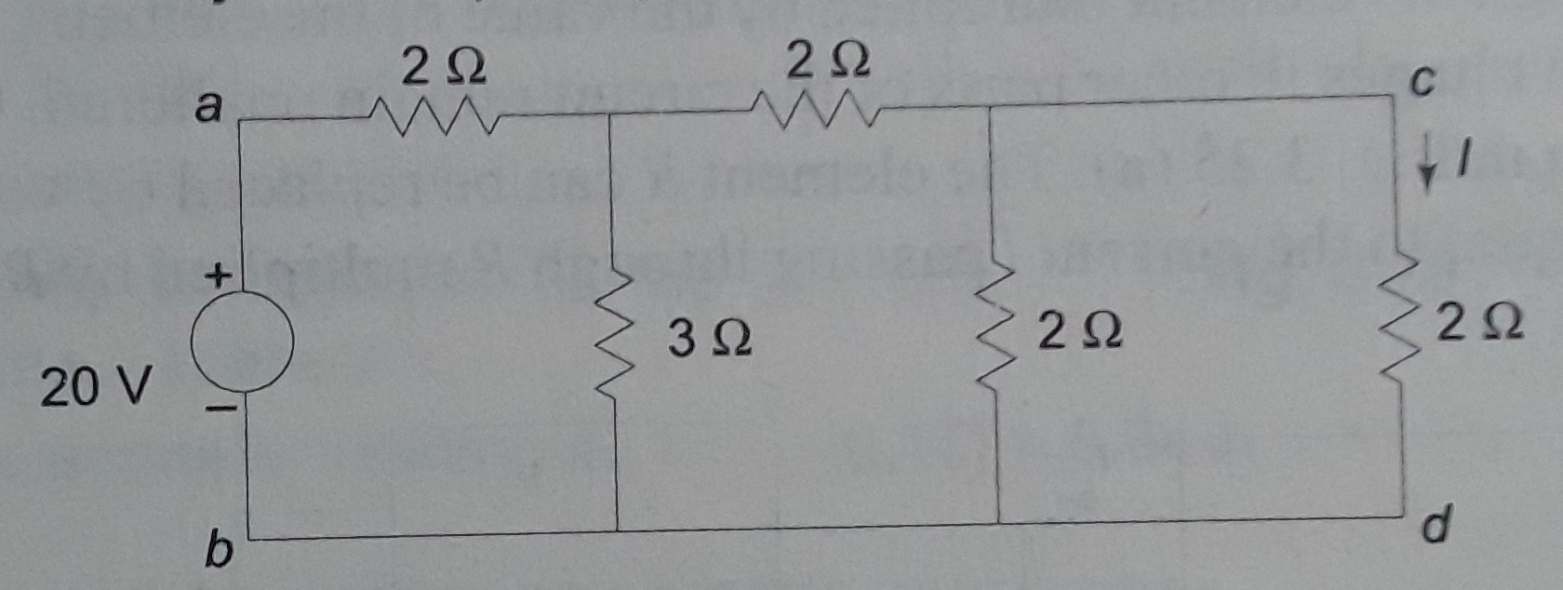
Pro.17: Verify the reciprocity theorem for the network shown in the figure.

Slide 65
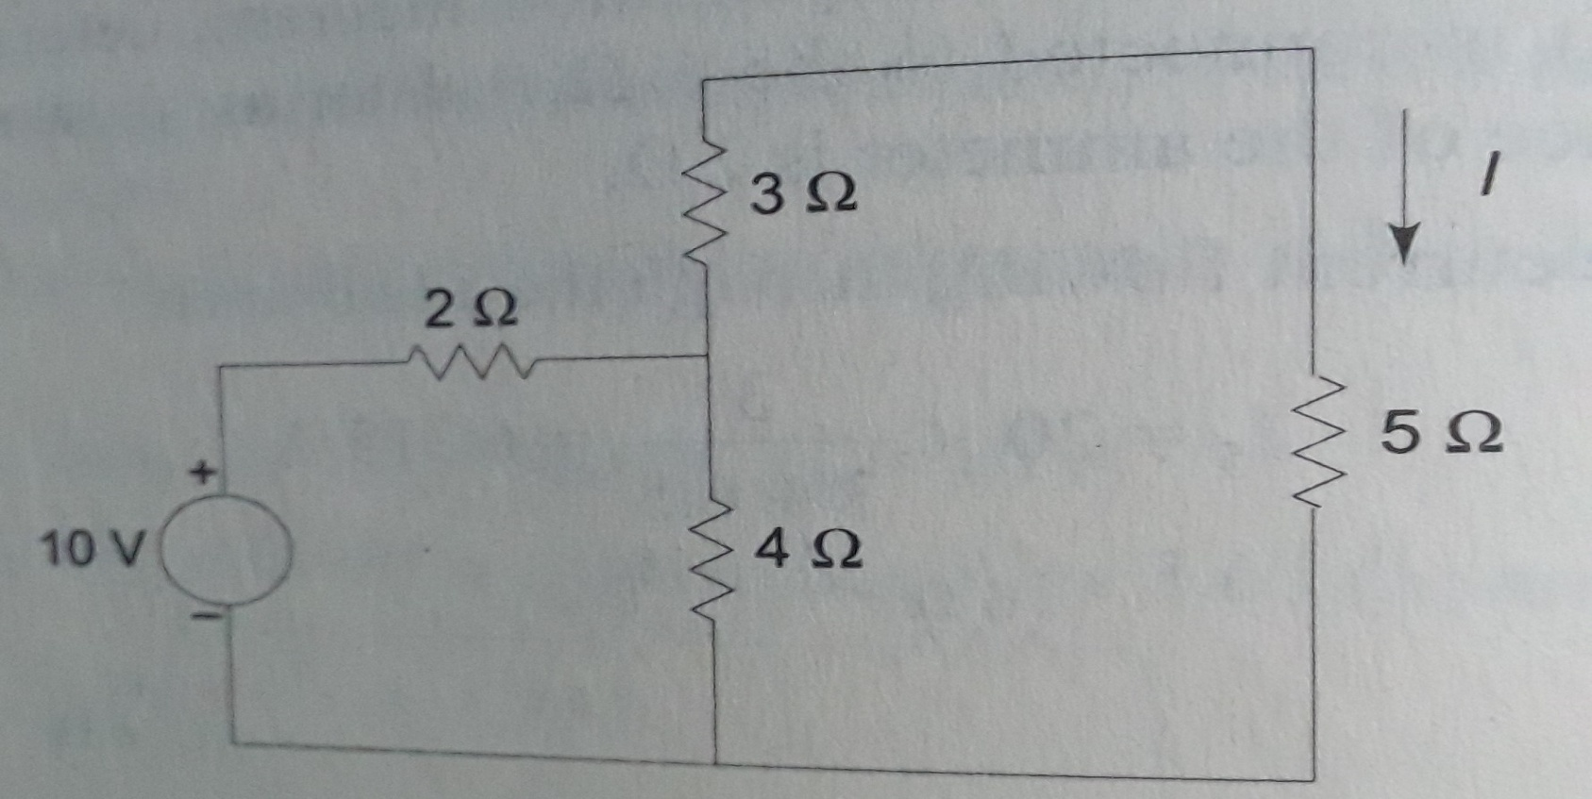
Pro.18: Verify the reciprocity theorem for the given circuit shown in the figure.

Slide 66
DC Machines
Principle of operation of D.C generators
A DC machine is an electro-mechanical energy conversion device.
When it converts mechanical power ( T) into DC electrical power (VI), it is known as a DC generator. On the other hand, when it converts DC electrical power into mechanical power it is known as a DC motor.
The energy conversion is based on the principle of the production of dynamically induced emf.
Although battery is an important source of DC electric power, but it can supply limited power.

Slide 67
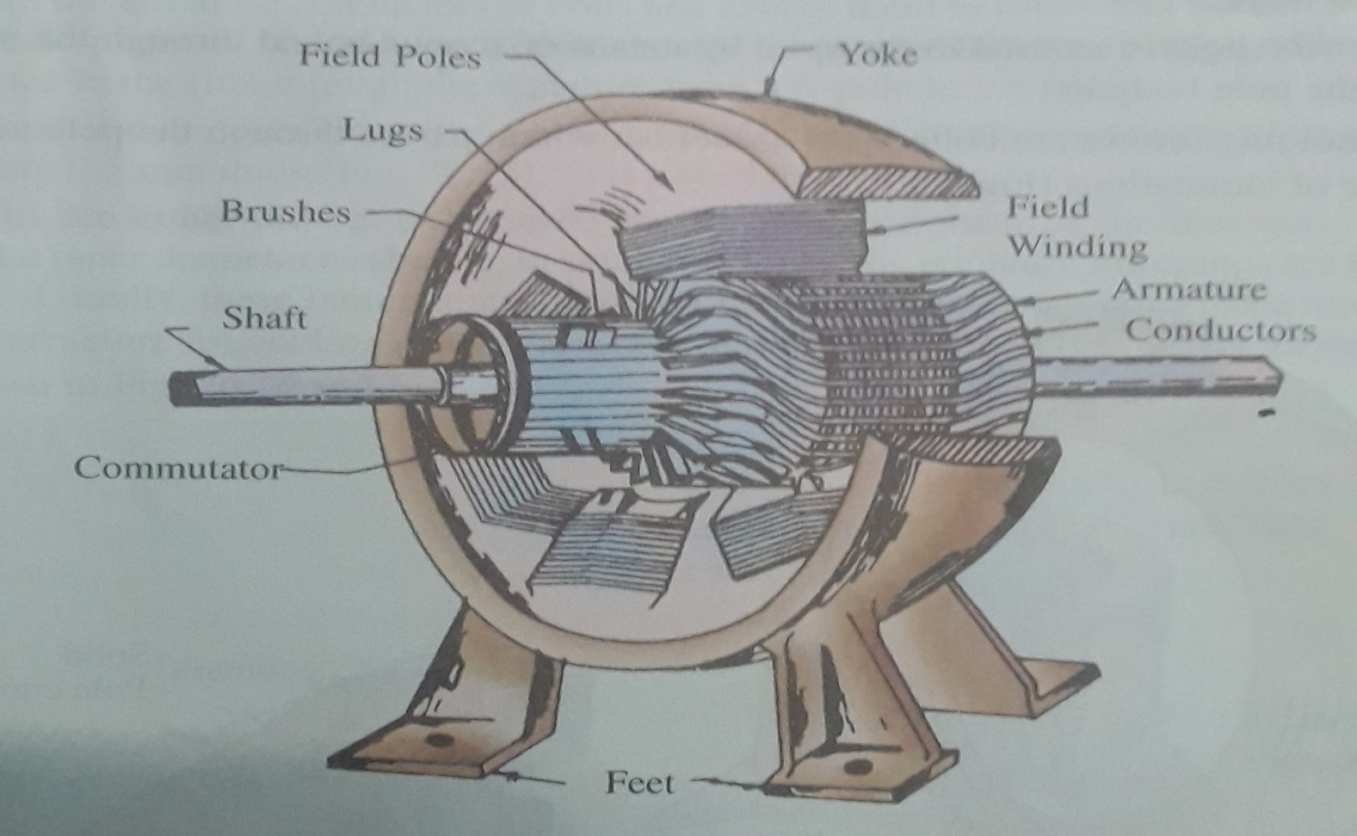
The 3D-diagram of the main parts of a 6-pole DC Generator or DC Machine is shown below.

Slide 68
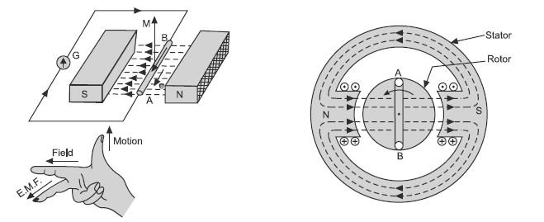
The basic principle of a DC generator is electro-magnetic induction i.e., whenever a conductor cuts magnetic flux, dynamically induced emf is produced in it according to Faraday's law of electromagnetic induction.
This emf causes a current to flow if a conductor circuit is closed. The direction of current is given by Flemings right hand rule.

Slide 69
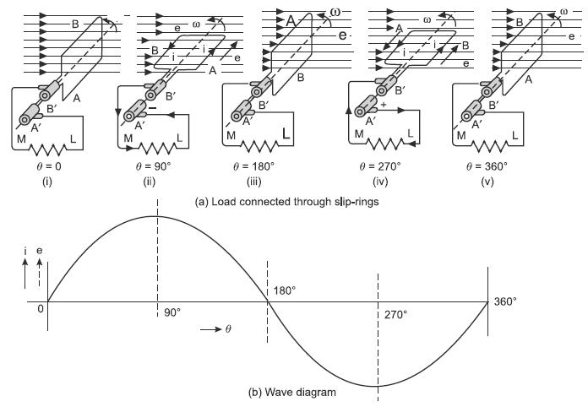
Simple Loop Generator and Function of Commutator
For simplicity, consider only one coil AB placed in the strong magnetic field. The two ends of the coil are joined to slip rings A and B respectively. Two brushes rest on these slip rings as shown in Fig.1.
Fig. 1. Generated emf for external circuit connected through slip rings

Slide 70
When this coil is rotated in counter clockwise direction at an angular velocity of radius per second, the magnetic flux is cut by the coil and an emf is induced in it.
The position of the coil at various instants is shown in Fig.1(a) and the corresponding value of the induced emf and its direction is shown in Fig. 1(b).
The induced emf is alternating and the current flowing through the external resistance is also alternating i.e., at second instant current flows in external resistance from M to L, whereas, at fourth instant it flows from L to M as shown in Fig. 1(b).

Slide 71
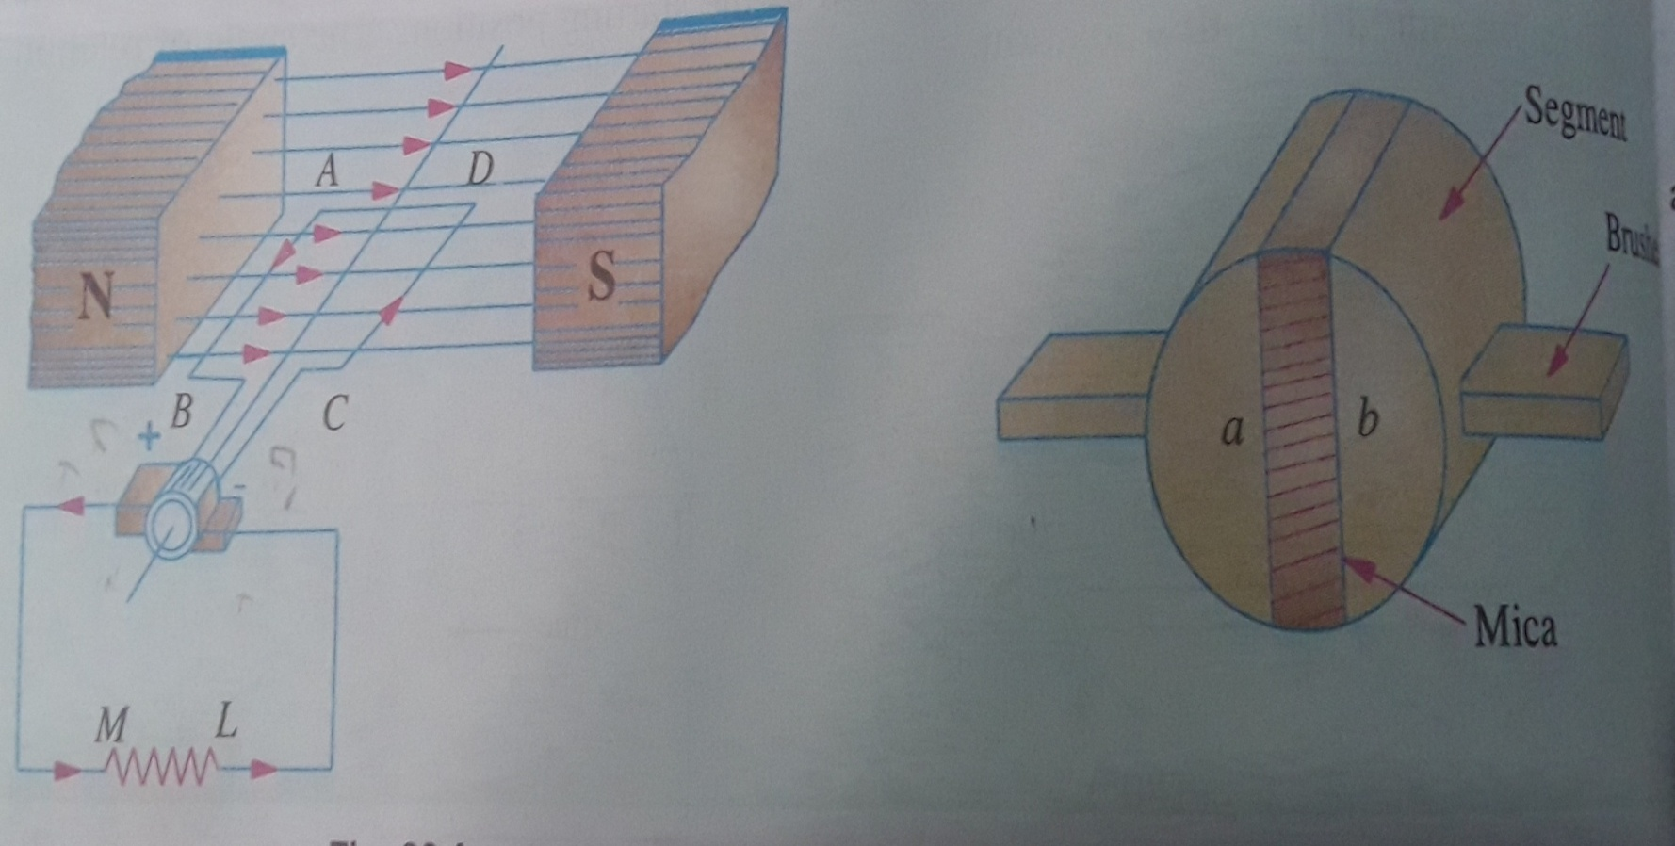
Commutator Action: The split-rings are made out of a conducting cylinder which is cut into two haves or segments insulated from each other by a thin sheet of mica. The coil ends are joined to these segments on which rest the carbon brushes.

Slide 72
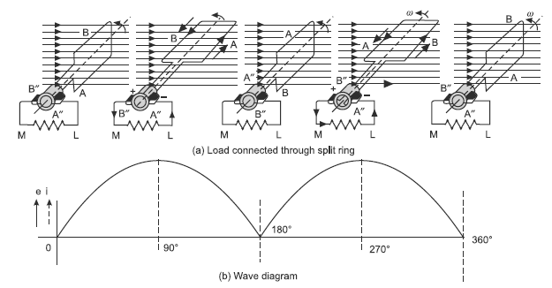
Fig. 2. Generated emf for external circuit connected through split ring
Observe above Fig.2, the flow of current in the external resistor or circuit will become unidirectional i.e., at second instant the flow of current in the external resistor is from M to L as well as the flow of current in the external resistor is from M to L in the fourth instant, as shown in Fig. 2(a). Its wave shape is shown in Fig. 2(b).

Slide 73
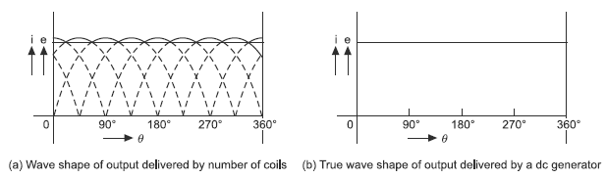
Hence, an alternating current is converted into unidirectional current in the external circuit with the help of a split ring (i.e., commutator).
Fig. 3. Wave shape of output delivered by a DC generator
In an actual machine, there are number of coils connected to the number of segments of the ring called commutator. The emf or current delivered by these coils to the external load is shown in Fig. 3(a). The actual flow of current flowing in the external load is shown by the firm line which fluctuates slightly. The number of coils placed on the armature is even much more than this and a pure direct current is obtained at the output as shown in Fig. 3(b).
Thus, in actual machine working as a generator, the function of commutator is to convert the alternating current produced in the armature into direct current in the external circuit.

Slide 74
EMF Equations of a Generator
As the armature rotates, a voltage is generated in its coils. In the case of a generator, the emf of rotation is called the Generated emf (Eg).
Let,
P – Number of poles of the machine
ϕ – Flux per pole in Weber
Z – Total number of armature conductors
N – Speed of armature in revolution per minute (r.p.m)
A – Number of parallel paths in the armature winding
Eg- e.m.f indued in any one of the parallel paths

Slide 75
In one revolution of the armature, the flux cut by one conductor is given asthe flux cut by one conductor = weber (1)
Time taken to complete one revolution is (2)
Therefore, the average induced e.m.f in one conductor will be
(3)
The number of conductors connected in series in each parallel path = Z/A, the average induced e.m.f across each parallel path or the armature terminals is given by the equation shown below.

Slide 76
(4)
Note: Simplex wave winding no of parallel paths A=2 and Simplex Lap winding no of parallel paths A= no. of poles (P)
Problem 19: A DC generator carries 600 conductors on its armature with lap connections. The generator has 8 poles with 0.06 Wb useful flux. What will be the induced emf at its terminals if it is rotated at 1000 rpm? Also determine the speed at which it should be driven to induce the same voltage with wave connections?
Problem 20: A six-pole machine has an armature with 90 slots and 8 conductors per slot, the flux per pole is 0.05Wb and rms at 1000 rpm. Determine induced emf if winding is (i) lap connected (ii) wave connected.

Slide 77
Problem 20: A DC generator carries 600 conductors on its armature with lap connections. The generator has 8 poles with 0.06 Wb useful flux. What will be the induced emf at its terminals if it is rotated at 1000 rpm? Also determine the speed at which it should be driven to induce the same voltage with wave connections?
Problem 21: A six-pole machine has an armature with 90 slots and 8 conductors per slot, the flux per pole is 0.05Wb and rms at 1000 rpm. Determine induced emf if winding is (i) lap connected (ii) wave connected.

Slide 78
Types of DC Generators
D.C. generators are generally classified according to the methods of their field excitation. On the basis of this criteria, they can be classified as:
1. Separately excited DC generators
2. Self excited DC generators – these are further classified as:
(i) Shunt wound DC generators
(ii) Series wound DC generators
(iii) Compound wound DC generators.
(a) Long shunt compound wound generators
(b) Short shunt compound wound generators.

Slide 79
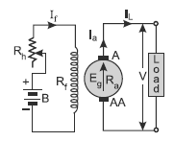
1. Separately excited DC generator:
A DC generator in which current is supplied to the field winding from an external DC source is called a separately excited DC generator.
Fig. 1. Circuit diagram for separately excited DC generator
I_{a} = Armature current, I_{L} = Load current, V = Terminal voltage,
R_{a} = Armature resistance, Here, I_{a}=I_{L} (current in series)
The voltage across the load (V)=E_{g} – I_{a}. R_{a}
The power developed (P_{g})=E_{g}. I_{a}
The power delivered to external load (P_{L})= V. I_{L} =V. I_{a}

Slide 80
2. Self excited DC generator:
A DC generator whose field winding is excited by the current supplied by the generator itself is called a self-excited DC generator.
In a self-excited DC generator, the field coils may be connected in parallel with the armature, in series with the armature or partly in series and partly in parallel with the armature winding.
Accordingly, the self-excited generators may be classified as
(i) Shunt wound generators
(ii) Series wound generators
(iii) Compound wound generators.

Slide 81
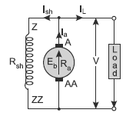
i. Shunt Generator: In a shunt wound generator, the field winding is connected across the armature winding forming a parallel or shunt circuit.
Therefore, full terminal voltage is applied across the field winding. A very small current I_{sh} flows through it because this winding has many turns of fine wire having very high resistance R_{sh} (of the order of 100 ohm). Its conventional diagram is shown in Fig. 2.
I_{sh} = shunt field current
R_{sh} = Shunt field resistance
Fig. 2 Circuit diagram for DC shunt generator

Slide 82
Where I_{a}=I_{sh} + I_{L} , Shunt field current is equal to
The voltage across the load (V)= E_{g} - I_{a}.R_{a}
The power generated (P_{g})=E_{g}. I_{a}
The power delivered to external load (P_{L})=V. I_{L}
Problem 21: A shunt generator delivers 150 A at 224V and the resistance of the shunt field and armature are 87 ohm and 1.3 ohm respectively. Calculate shunt field and armature current, generator emf, power generated, power delivered and copper loses.
Problem 22: A 12-pole DC shunt generator has 50 slots on its armature with 12 conductors per slot with wave winding. The armature and field winding resistance is 0.5 ohm and 60 ohm respectively. The generator is supplying a resistive load of 15 ohm at terminal voltage of 300 V when running at a speed of 625 rpm. Find the armature current, the generated emf and the flux per pole.

Slide 83
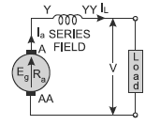
ii. Series Generator: In a series wound generator, the field winding is connected in series with the armature winding forming a series circuit. Therefore, full line current I_{L} or armature current I_{a} flows through it. Since the series field winding carries full load current, it has a few turns of thick wire having low resistance (usually of the order of less than one ohm). Its conventional diagram is shown in Fig. 1.
Let I_{a}=I_{se}=I_{L}= I current in series ,
The voltage across the load
(V)= E_{g} -I( R_{a} +R_{se} ),
the power generated (P_{g})=E_{g}.I
The power delivered to external load (P_{L})=V.I
Fig. 1.Circuit diagram for DC series generator

Slide 84
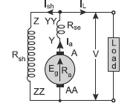
iii. Compound Wound Generators: In a compound wound generator, there are two sets of field windings on each pole. One of them is connected in series and the other is connected in parallel with armature. A compound wound generator may be;
(a) Long shunt in which the shunt field winding is connected in parallel with the combination of both armature and series field winding. The conventional diagram of lone shunt compound generator is shown in Fig. 1.
Shunt field current
Series field current
Terminal voltage
Power developed =
Power output =
Fig. 1.Circuit diagram for long shunt DC compound generator

Slide 85
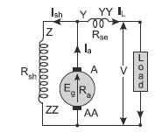
(b) Short shunt in which the shunt field winding is connected in parallel with only armature winding. The conventional diagram of short shunt compound generator is shown in Fig. 2.
Shunt field current
Series field current
Terminal voltage
Power developed =
Power output =
Fig. 2.Circuit diagram for short shunt DC compound generator

Slide 86
Problem 23: A load of 20 kW at 230 V is supplied by a compound DC generator. If the series, shunt field and armature resistances are 0·05, 115 and 0.1 ohm respectively. Calculate the generated emf when the generator is connected as long shunt.
Problem 24: A load of 7.5 kW at 230V is supplied by a short-shunt cumulatively compound DC generator. If the armature, series and shunt field resistances are 0·4, 0·3 and 100 ohm respectively. Calculate the induced emf and the load resistance.

Slide 87
D.C Motors
A machine that converts mechanical power into DC electrical power is called a DC generator. The same machine when used to convert DC electrical power into mechanical power, it known as a DC motor.
From construction point of view there is no difference between a DC generator and motor.
The DC motors are very useful where wide range of speeds and perfect speed regulation is required such as electric traction.
Electric motors are used for driving industrial machines, e.g., hammers, presses, drilling machines, lathes, rollers in paper and steel industry, blowers for furnaces, etc., and domestic appliances, e.g., refrigerators, fans, water pumps, toys, mixers, etc.

Slide 88
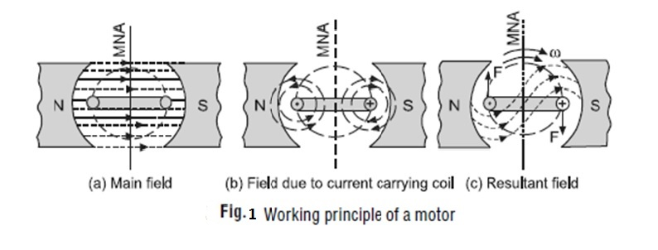
Principle of operation of D.C Motors
The principle of working of a DC motor is that "whenever a current carrying conductor is placed in a magnetic field, it experiences a mechanical force".
The direction of this force is given by Fleming's left hand rule and it's magnitude is given by F = BIL. This force tending to rotate the armature.
where, B = magnetic flux density, I = current and L = length of the conductor within the magnetic field.

Slide 89
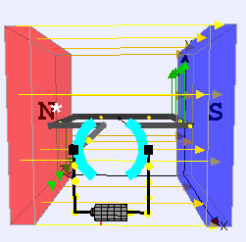
For simplicity, consider only one coil of the armature placed in the magnetic field produced by a bipolar machine [see Fig. 1(a)].
When DC supply is connected to the coil, current flows through it which sets up its own field as shown in Fig. 1(b).
By the interaction of the two fields (i.e., field produced by the main poles and the coil), a resultant field is set up as shown in Fig. 1(c).
The tendency of this is to come to its original position i.e., in straight line due to which force is exerted on the two coil sides and torque develops which rotates the coil.

Slide 90
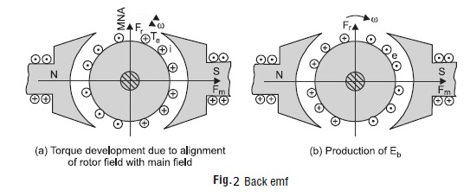
Back EMF Equations of a Motor
It has been seen that when current is supplied to the armature conductors, as shown in Fig. 2(a), placed in the main magnetic field, torque develops and armature rotates.
Simultaneously, the armature conductors cut across the magnetic field and an emf is induced in these conductors. The direction of this induced emf in the armature conductors is determined by Fleming’s Right Hand Rule and is marked in Fig. 2(b).

Slide 91
It can be seen that the direction of this induced emf is opposite to the applied voltage. That is why this induced emf is called back emf (Eb).
The magnitude of this induced emf is given by the relation;
The induced emf acts in opposite direction to the applied voltage V (Lenz’s law) and is known as Back EMF or Counter EMF (Eb).
The back emf (Eb) is always less than the applied voltage V.

Slide 92
Electro-Magnetic Torque Developed in DC Motor
The electrical power which is supplied to a DC motor is converted into mechanical power. The conversion of power takes place in the armature as stated below: The power developed in the armature is given as
For a particular machine, the number of poles (P), number of conductors per parallel path (Z/A) are constant.
The constant K for a given machine is the same for the emf equation as well as the torque equation.

Slide 93
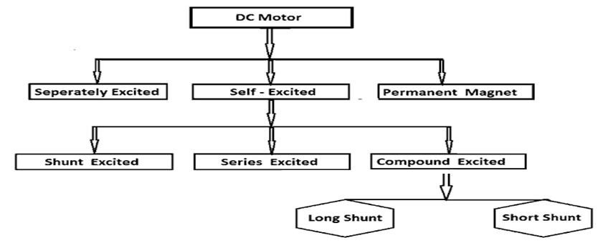
Problem 24: The induced emf in a DC machine is 200 V at a speed of 1200 rpm. Calculate the electromagnetic torque developed at an armature current of 15 A.
Types of DC Motors
DC motors are classified on the basis of the connections of armature and their field windings, DC motors can be classified as;

Slide 94
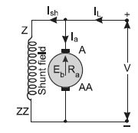
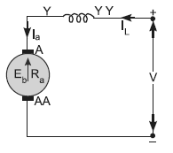


A DC shunt motor (also known as a shunt wound DC motor) is a type of self-excited DC motor where the field windings are shunted to or are connected in parallel to the armature winding of the motor.
In series motors stator windings and field windings are connected in series with each other. As a result the field current and armature current are equal. Heavy currents flow directly from the supply to the field windings.

Slide 95



In case of long shunt compound wound DC motor, the shunt field winding is connected in parallel across the series combination of both the armature and series field coil, as shown in the diagram below.
In case of short shunt compound wound DC motor, the shunt field winding is connected in parallel across the armature winding only. And series field coil is exposed to the entire supply current, before being split up into armature and shunt field current as shown in the diagram below.

Slide 96
Problem 25: A 400 V DC motor takes an armature current of 100 A when its speed is 1000 rpm If the armature resistance is 0·25 ohm, calculate the torque produced in Nm.
Problem 27: A dc motor connected to 440V supply and takes an armature current of 120A at full load. If the armature and filed circuit have 0.25 and 200 ohm resistance respectively. Determine the back emf, field and line currents, power required to overcome back emf and copper loss.
Problem 26: A 220V DC shunt machine has an armature resistance of 0.5 ohm. If the full load armature current is 20A, find the induced emf when the machine act as (i) Generator (ii) Motor.

Slide 97
THANK YOU

